Slide 1
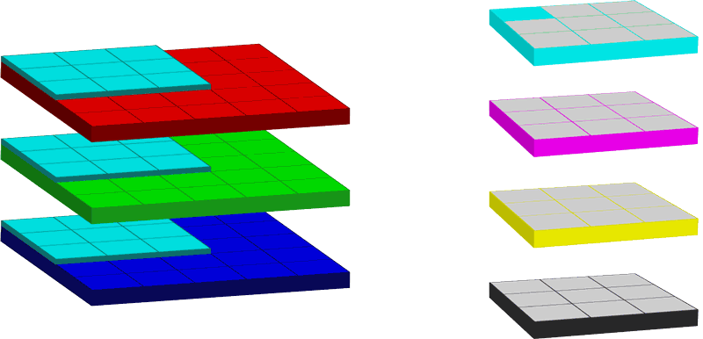
Convolutions
Notes:
Convolution is the application of a kernel to the image (RGB)

